Slide 1
Study Schedule

Slide 2
This project is divided into two parts:
1 – Web Application .
2 – Android Application.

Slide 3
Web Application

Slide 4
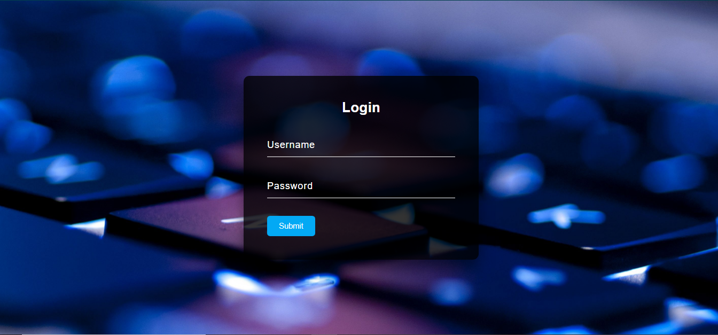
Login :

Slide 5
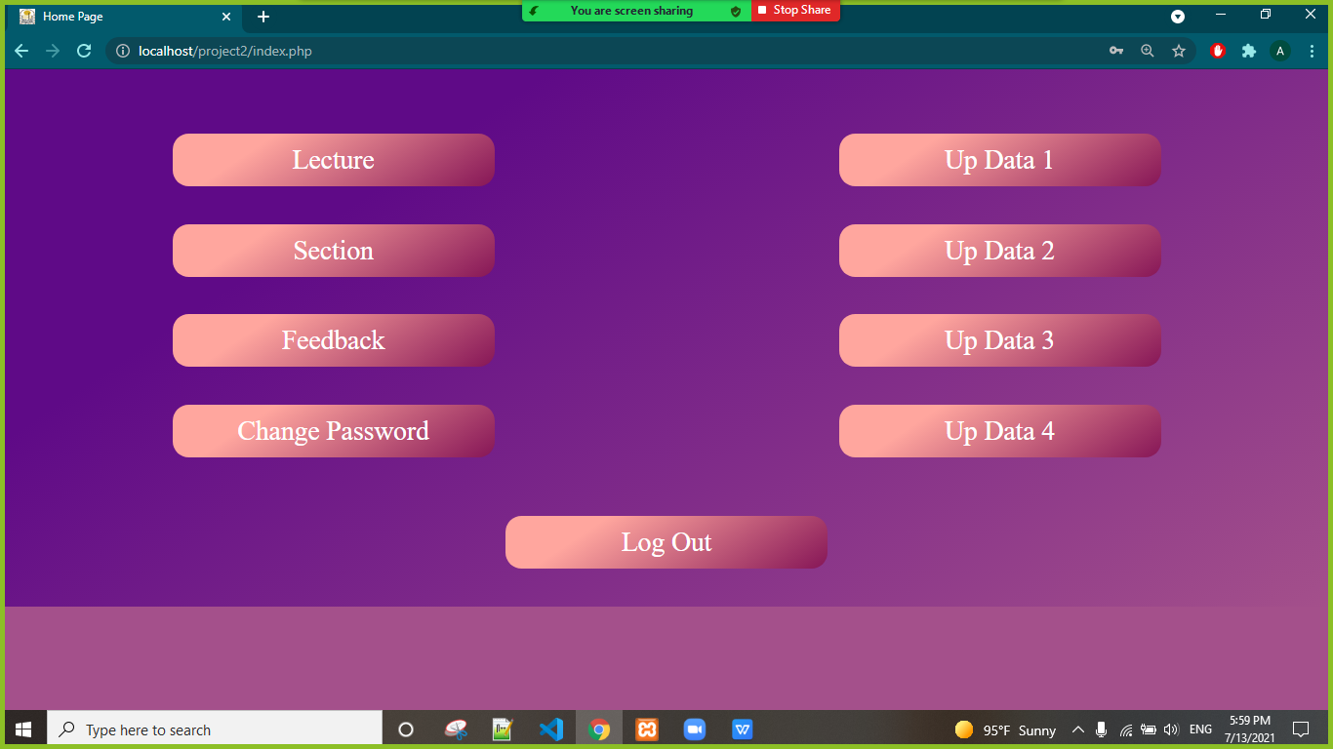
Home Page :
As much as I control the project by accessing all pages.

Slide 6
This page allows me to enter the data of the doctor who needs recorded in the table via:
1 - Name Of Doctor .
2 - Name Of Subject .
3 - Subject Time.
4 - Subject Type.
5 - Subject Day.
6 - Group Number.
7 - Class Number.

Slide 7
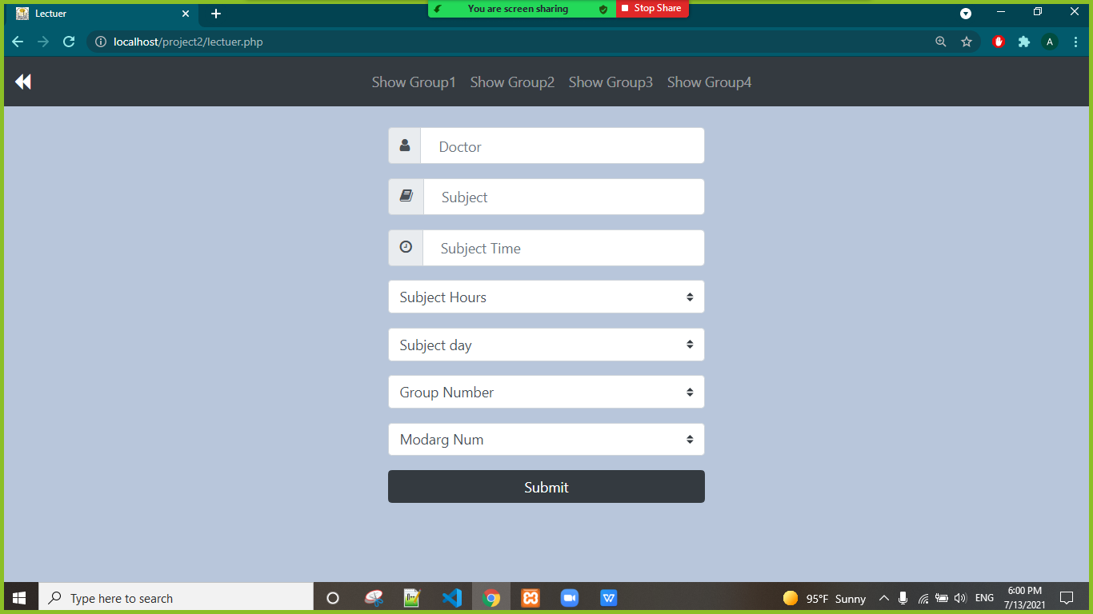
Lectuer Page :

Slide 8
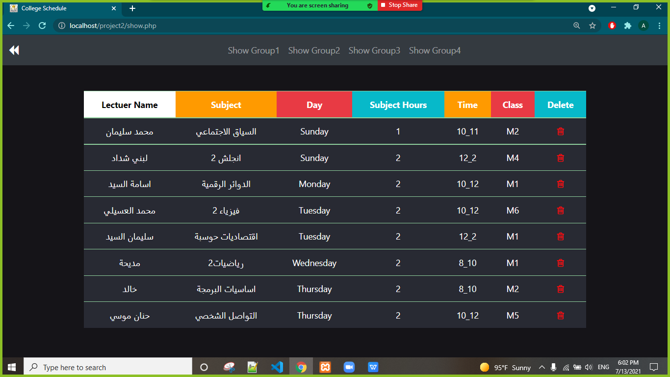
Show Lectuer Page :

Slide 9
This page allows me to enter the data of the Instruactor who needs recorded in the table via:
1 - Name Of Instruactor .
2 - Name Of Subject .
3 - Section Number
4 - Subject Type.
5 - Subject Day.
6 - Group Number.
7 - Class Number.

Slide 10
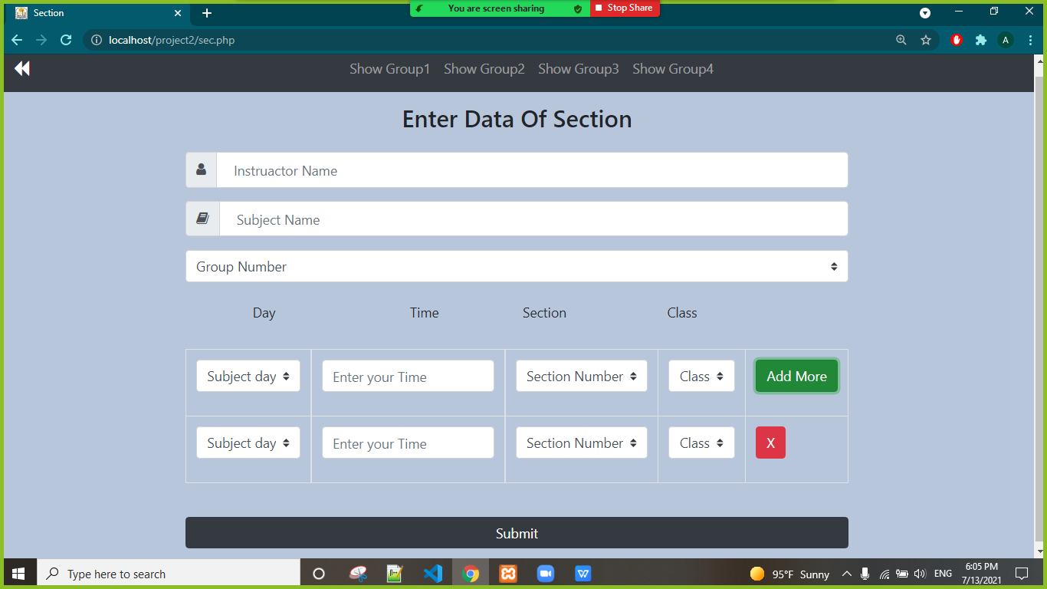
Section Page :

Slide 11
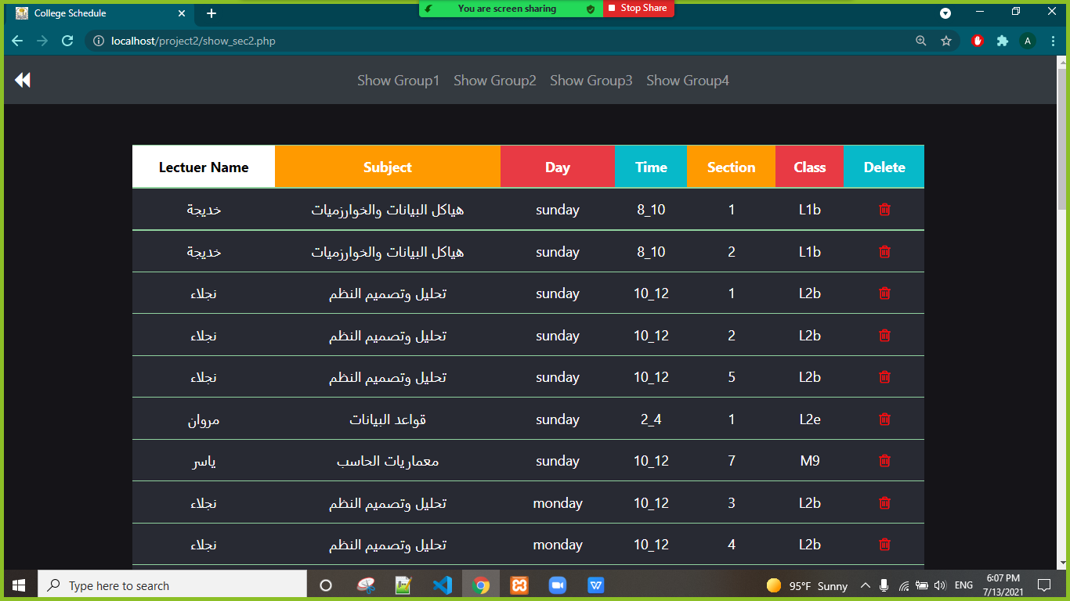
Show Section Page :

Slide 12
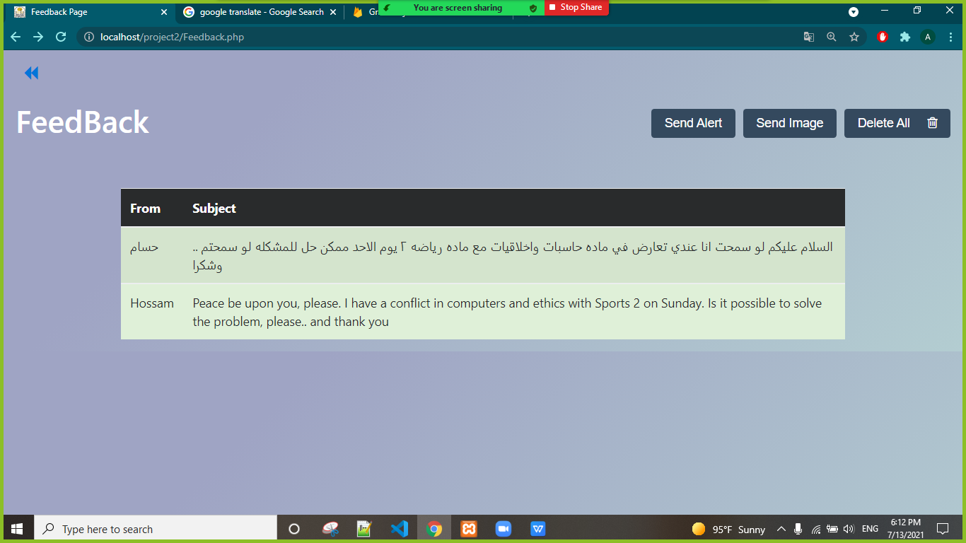
FeedBack Page :
We can send alerts to students (photos and messages) and we can receive feedback from students .

Slide 13
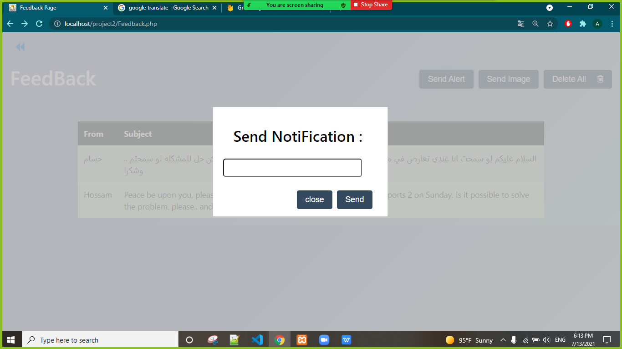
Send Notification

Slide 14
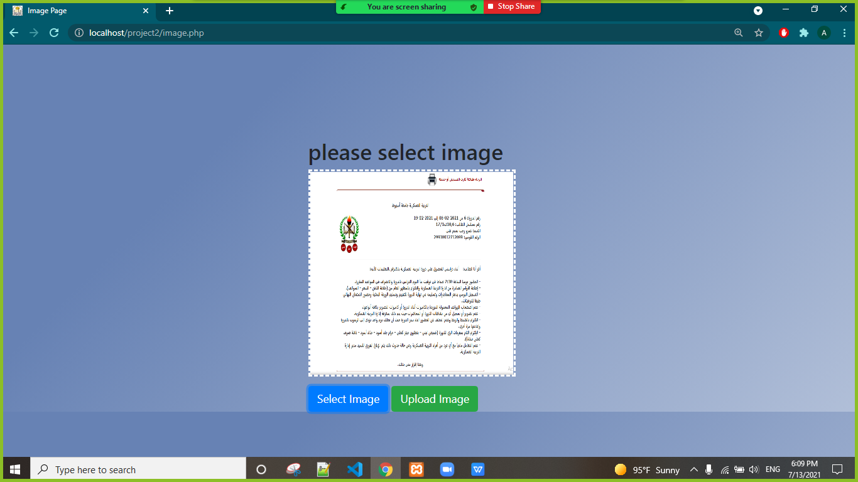
Image Page :

Slide 15
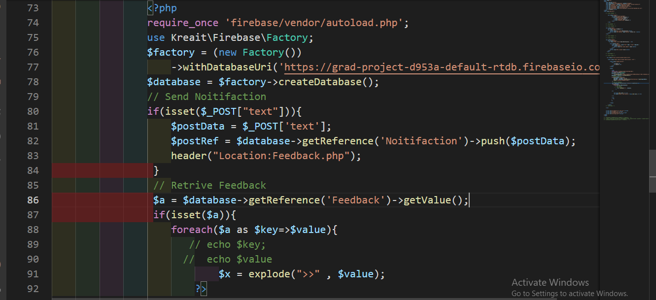
Saving Data And Retrieve Data From Fire Base :

Slide 16
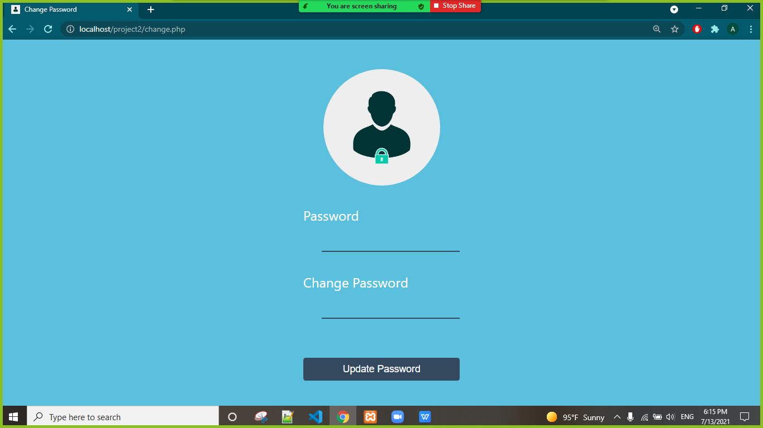
Change Password :

Slide 17
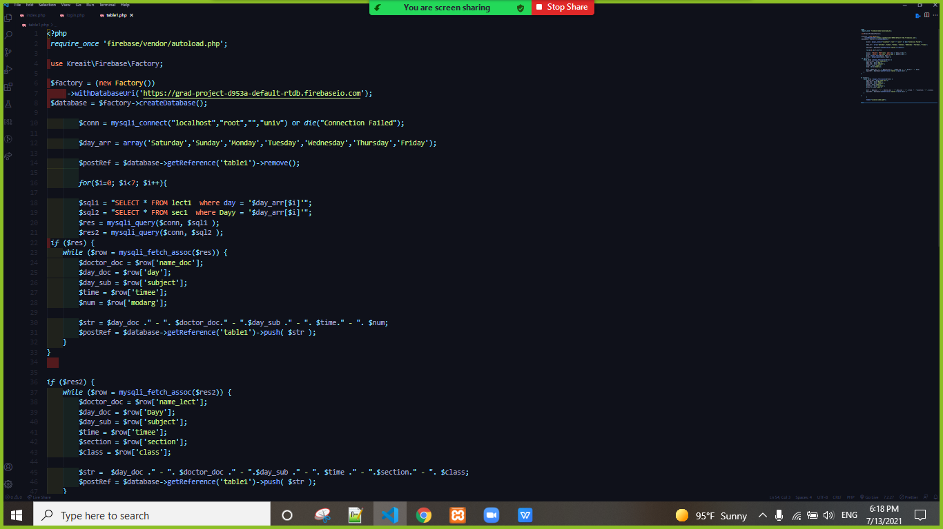
Code Up Data:
The data was sent to the students after we finished recording lectures and sessions for each batch .

Slide 18
Guide Notification System

Slide 19
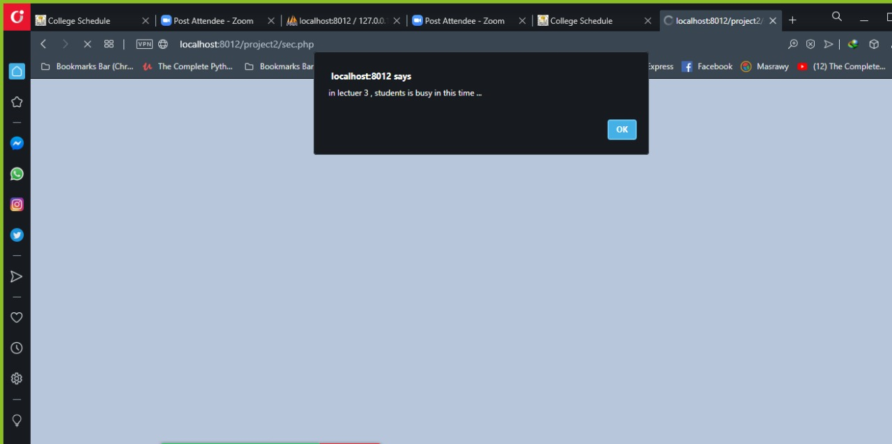
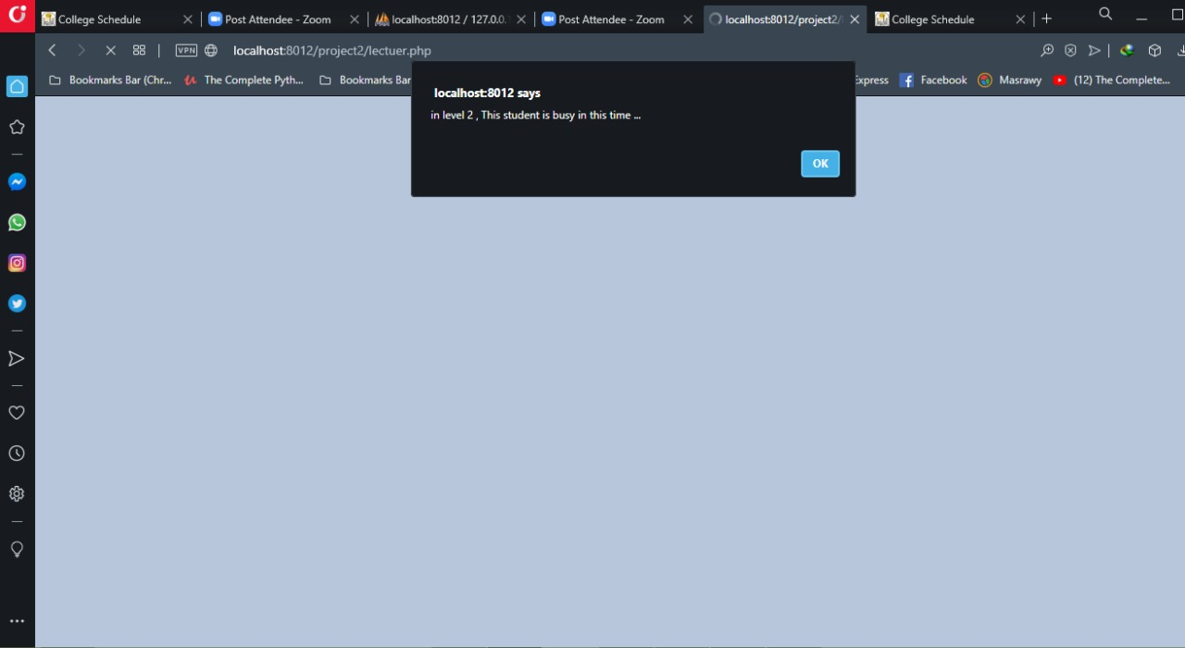
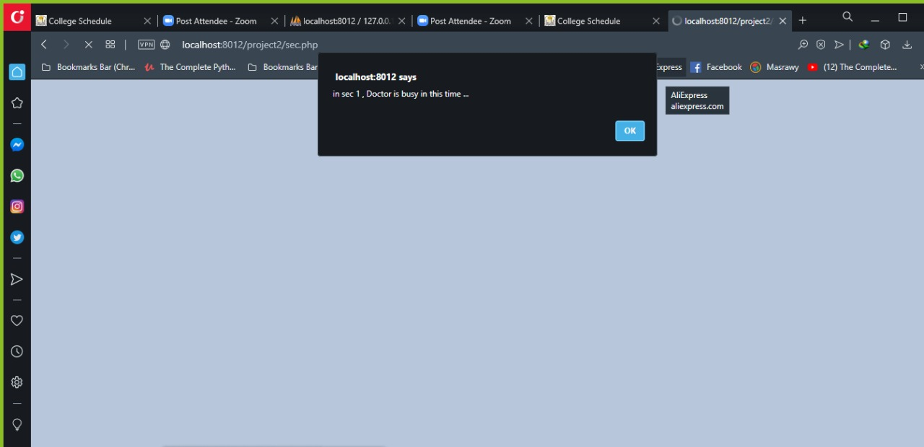

Slide 20
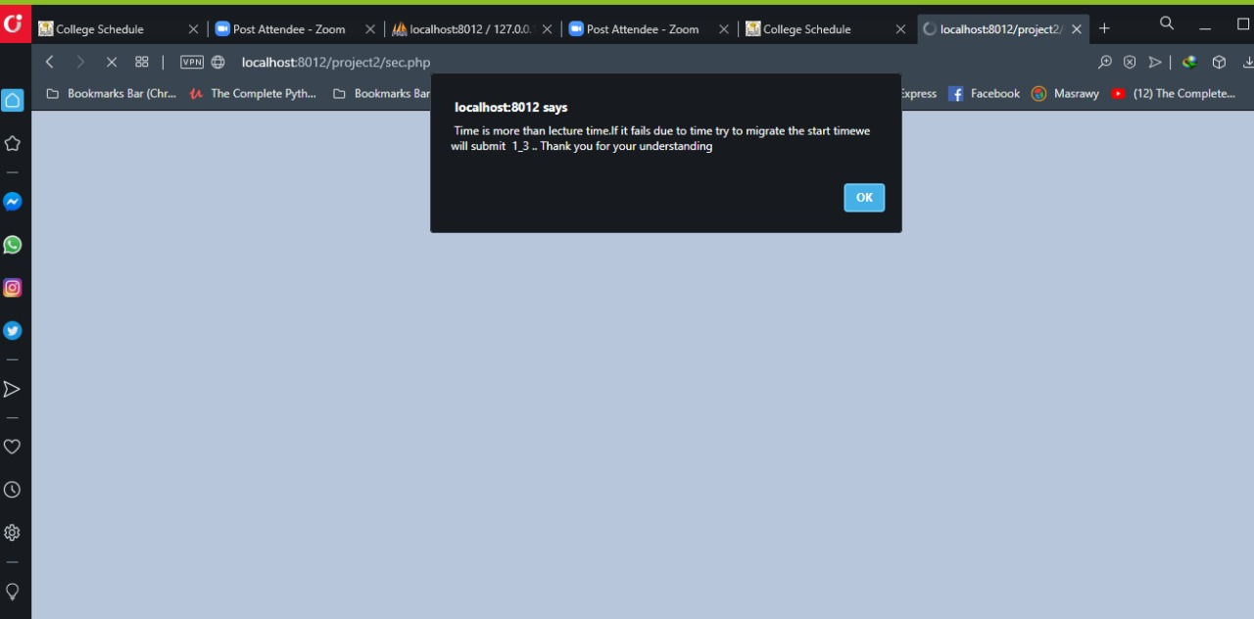
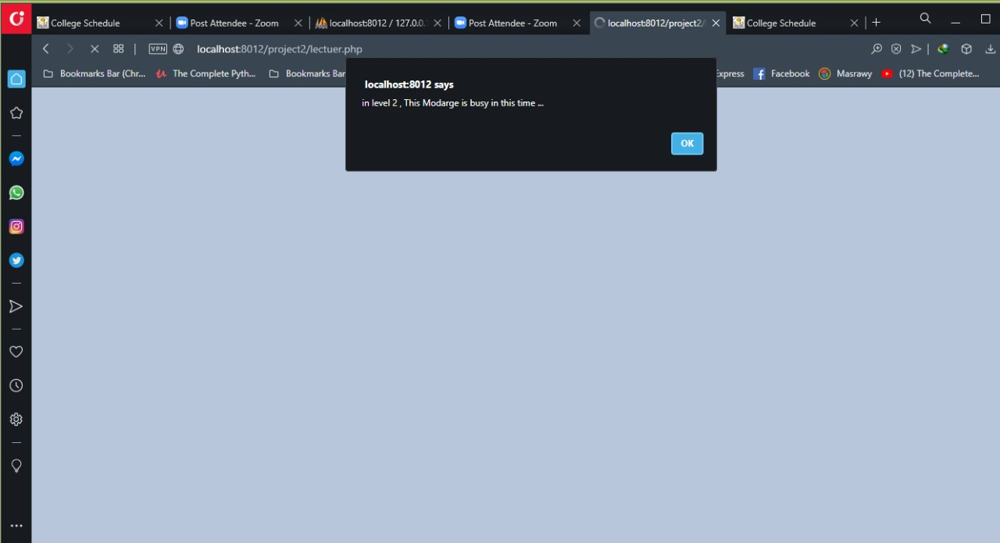
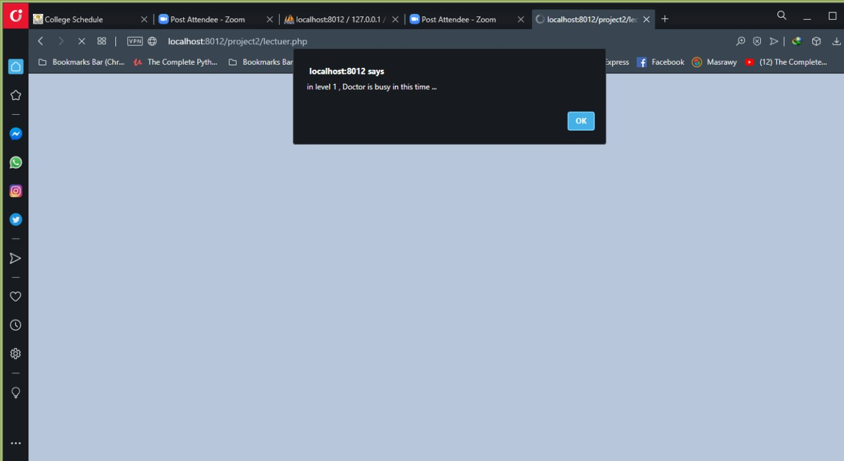

Slide 21
Android Application

Slide 22
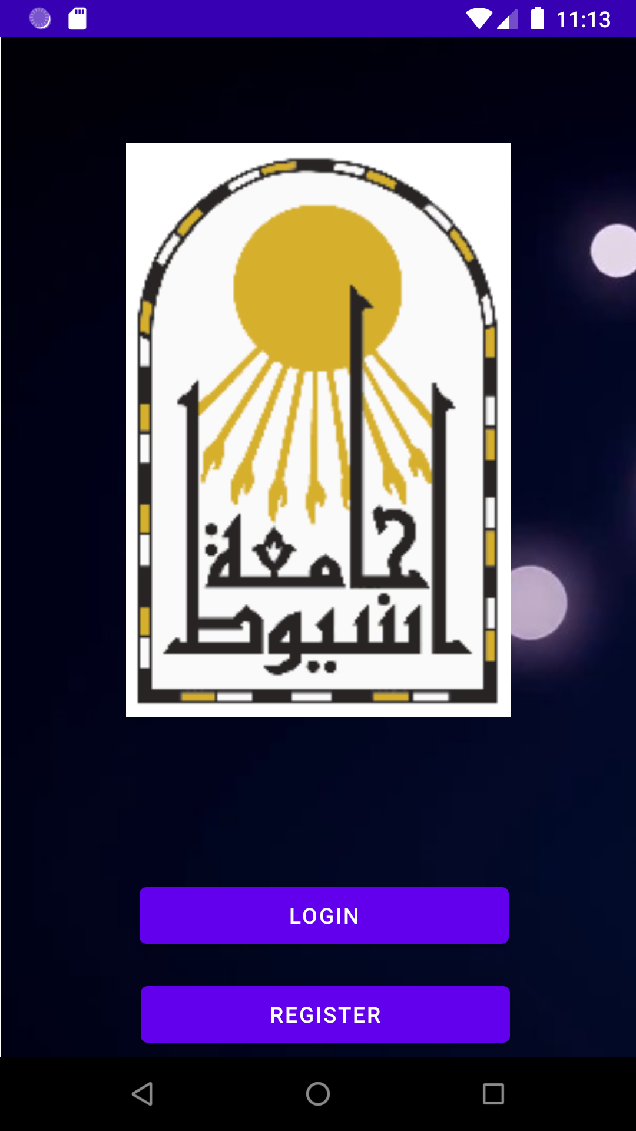
Android Application :
1 – You Can Log In .
2 – You Can Log Out .
3 – You Can Register .
4 – You Can Forget Password .
5 – Do Verify .
6 – Is Verified?
7 –Remember Me.

Slide 23
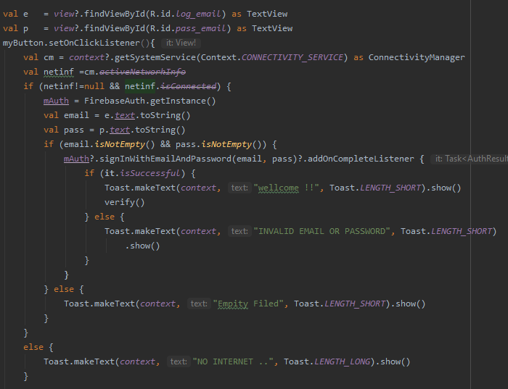
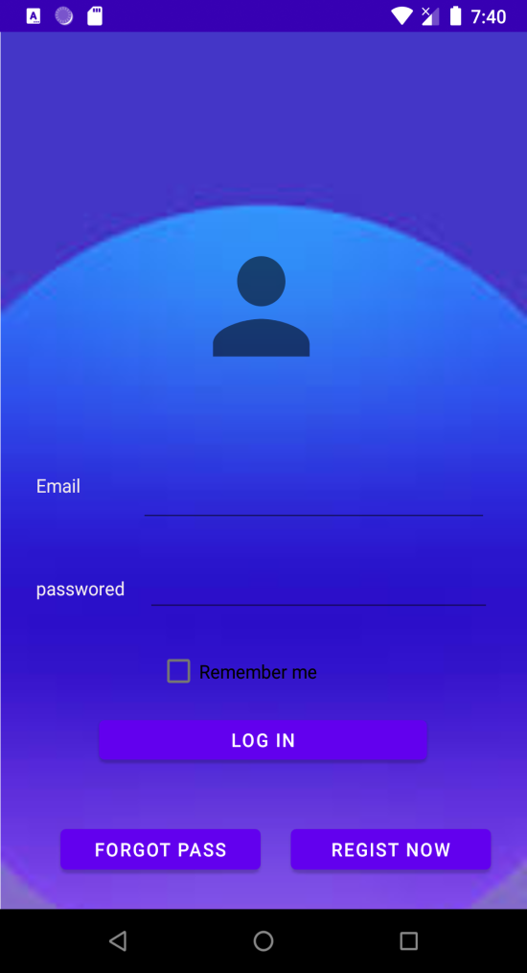
Log In :

Slide 24
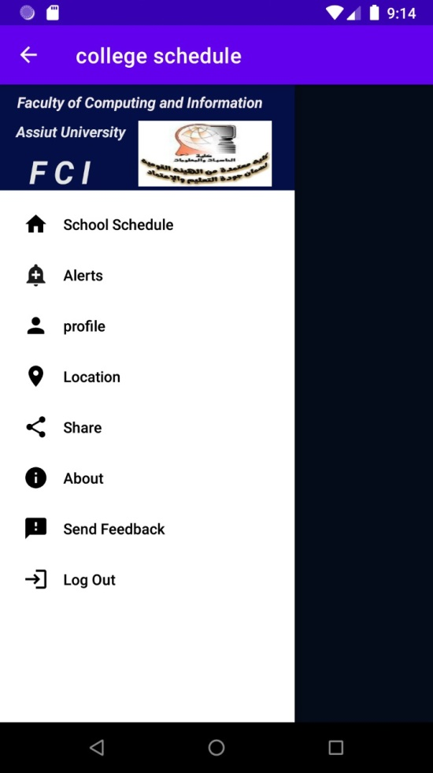
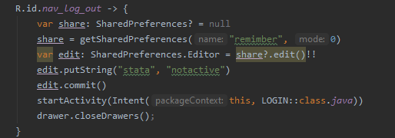
Log Out :

Slide 25
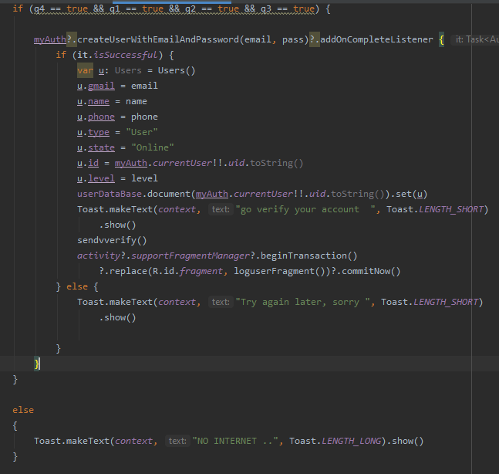
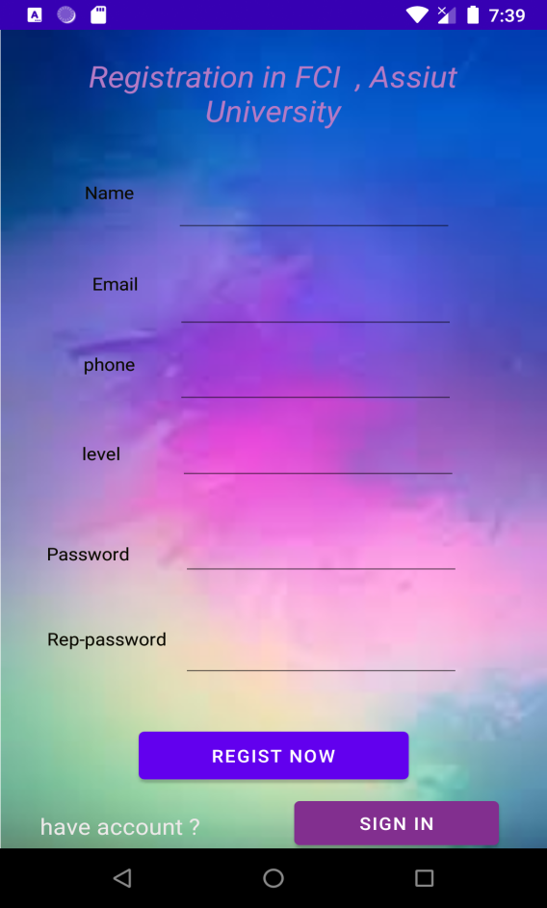
Register :

Slide 26
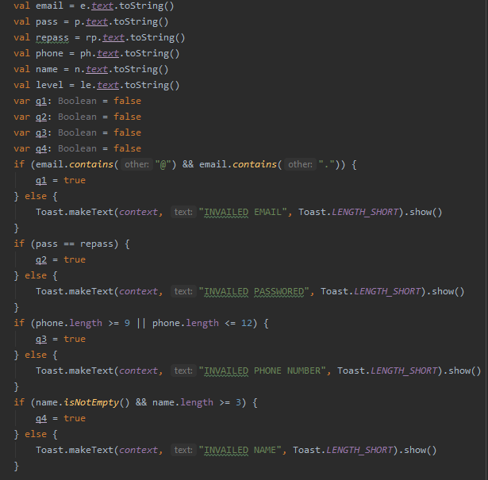

Slide 27
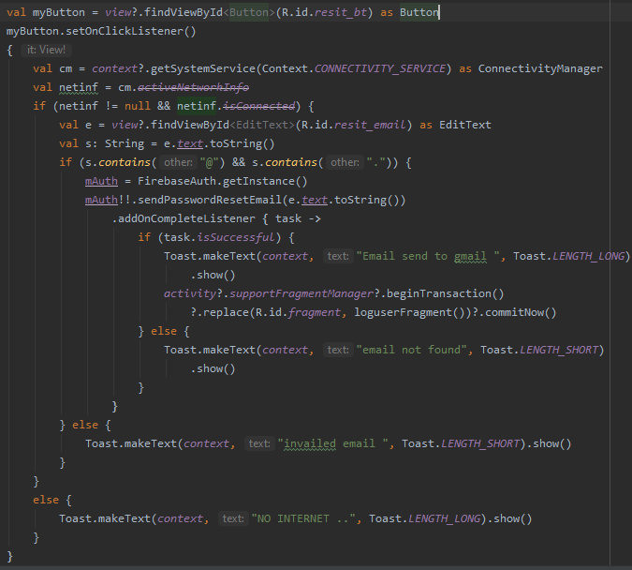
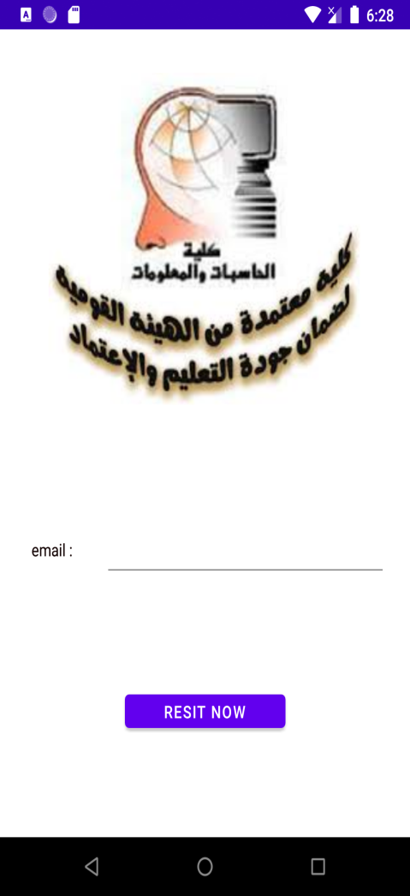
Forget Password :

Slide 28
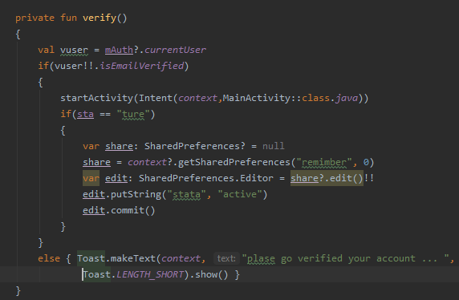
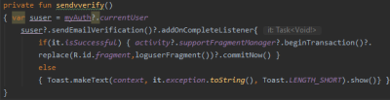
Send Verify , Is Verified?

Slide 29
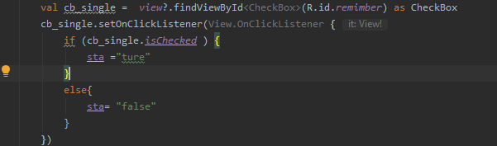
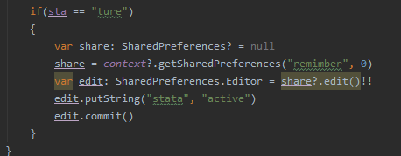
Remember Me :

Slide 30
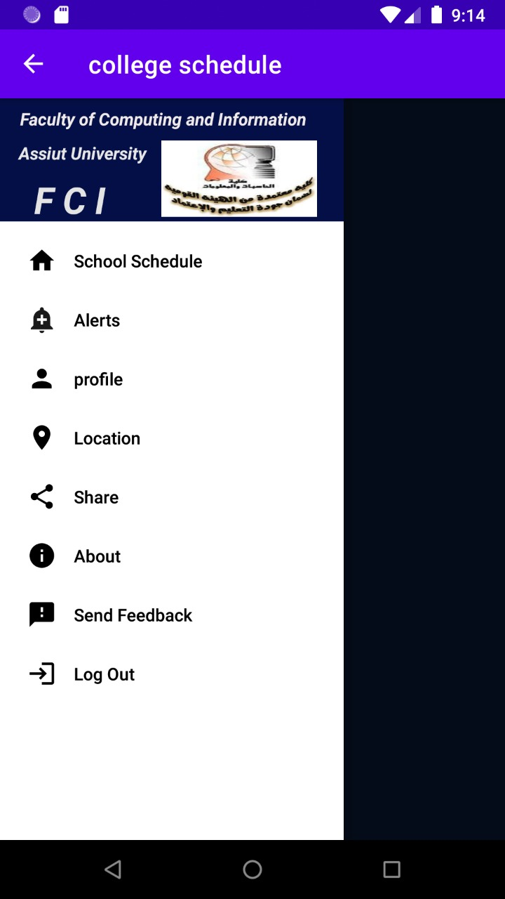
Android Application :
This application is used to :
1 - show student schedule .
2 - Receive Alerts .
3 - Send Feed Back .
4 - You can access the college website, location, and the page on Facebook .
5 - User Profile .
6 - Share Application .

Slide 31
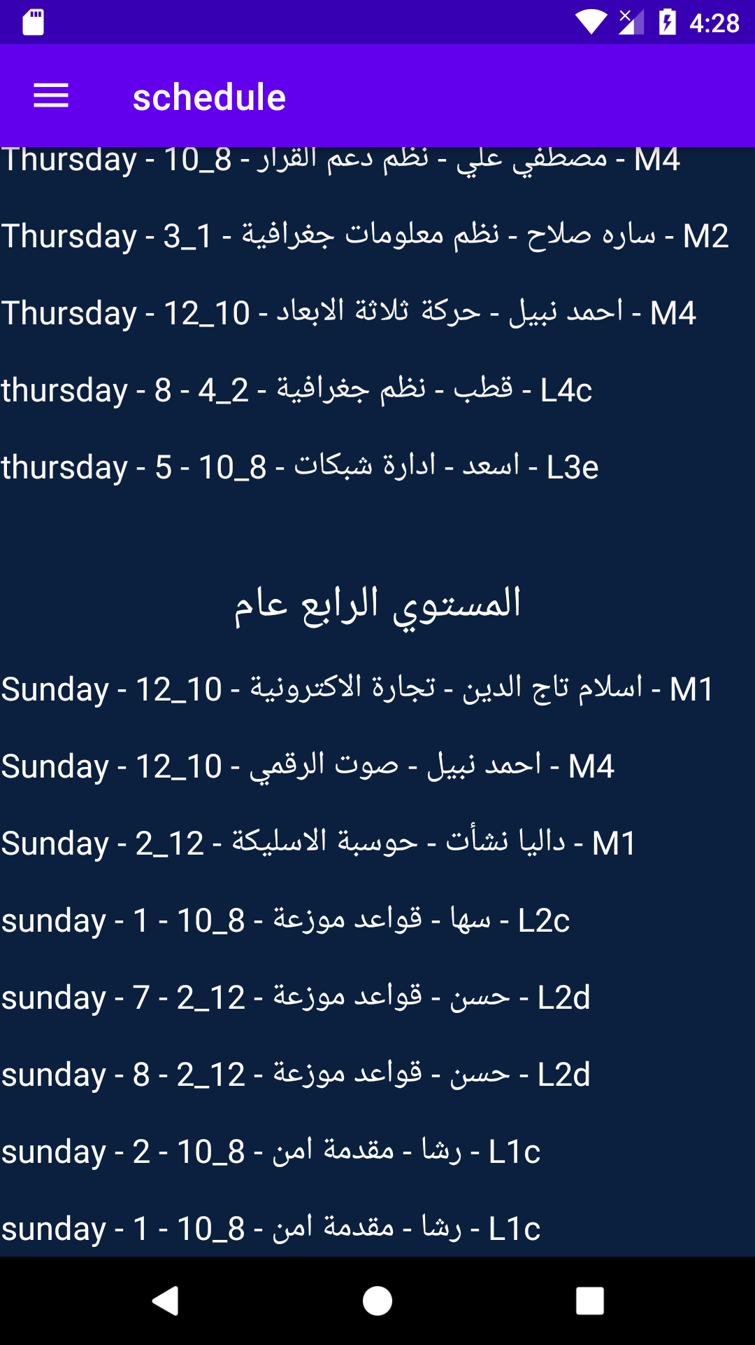
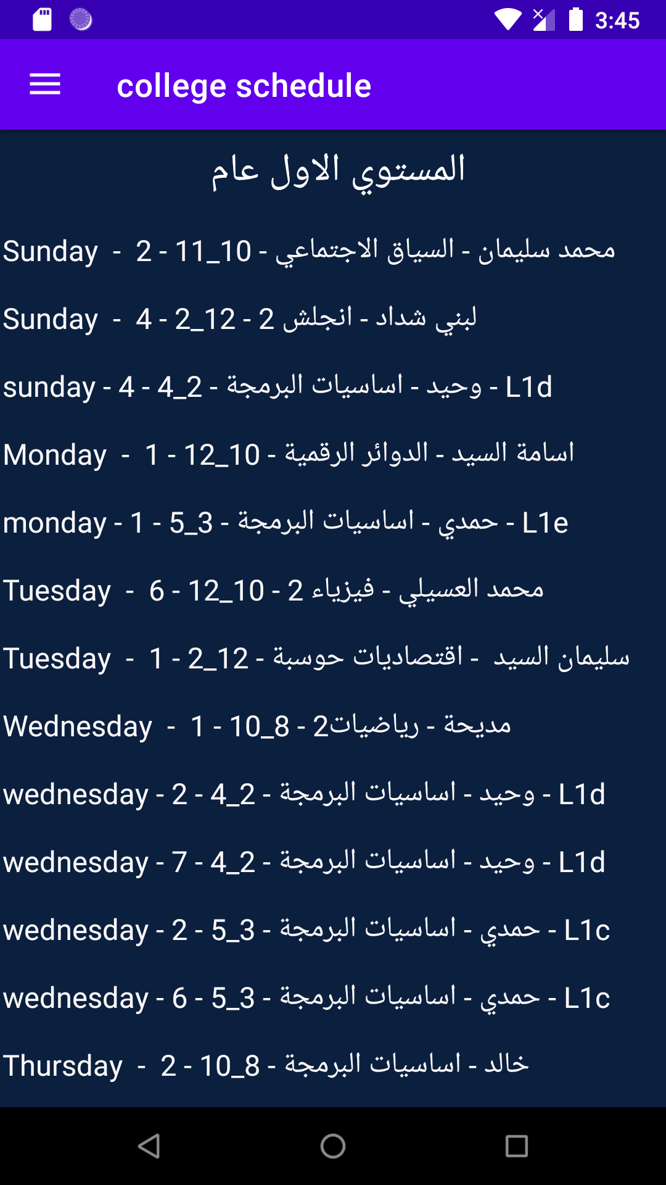
show student schedule :

Slide 32
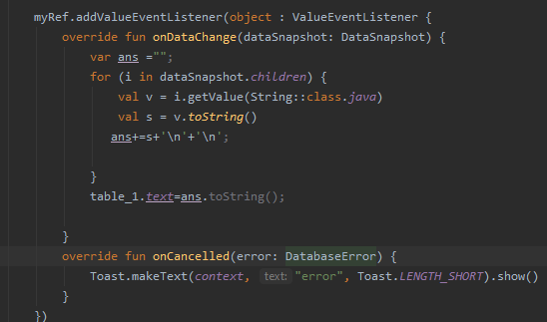

Slide 33
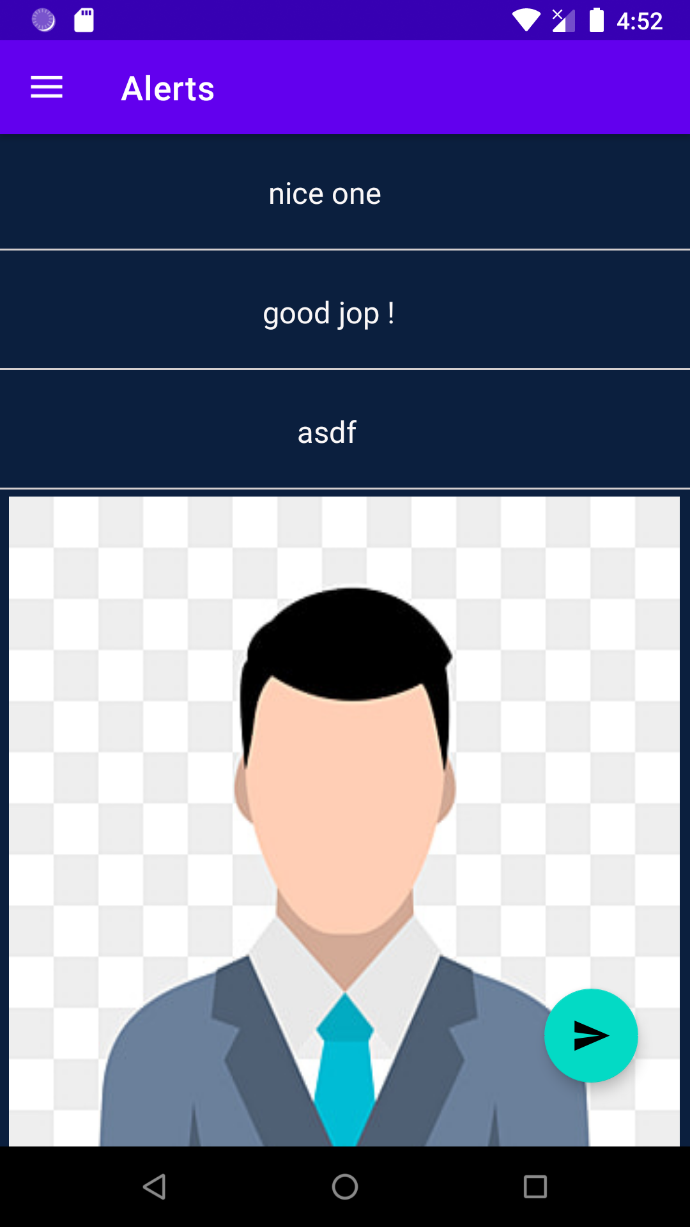
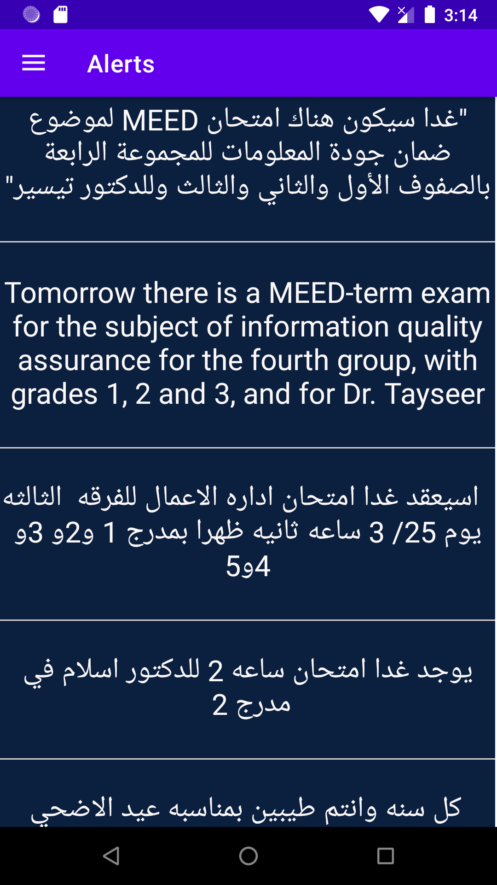
Receive Alerts (Message And Image) :

Slide 34
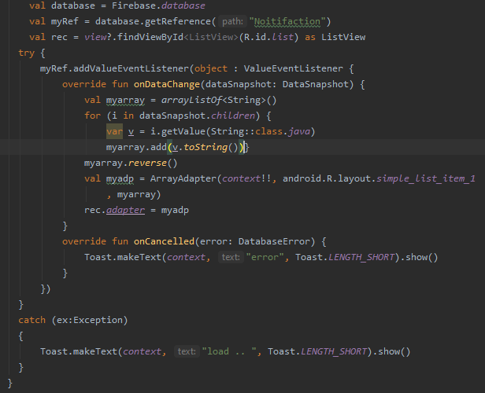

Slide 35
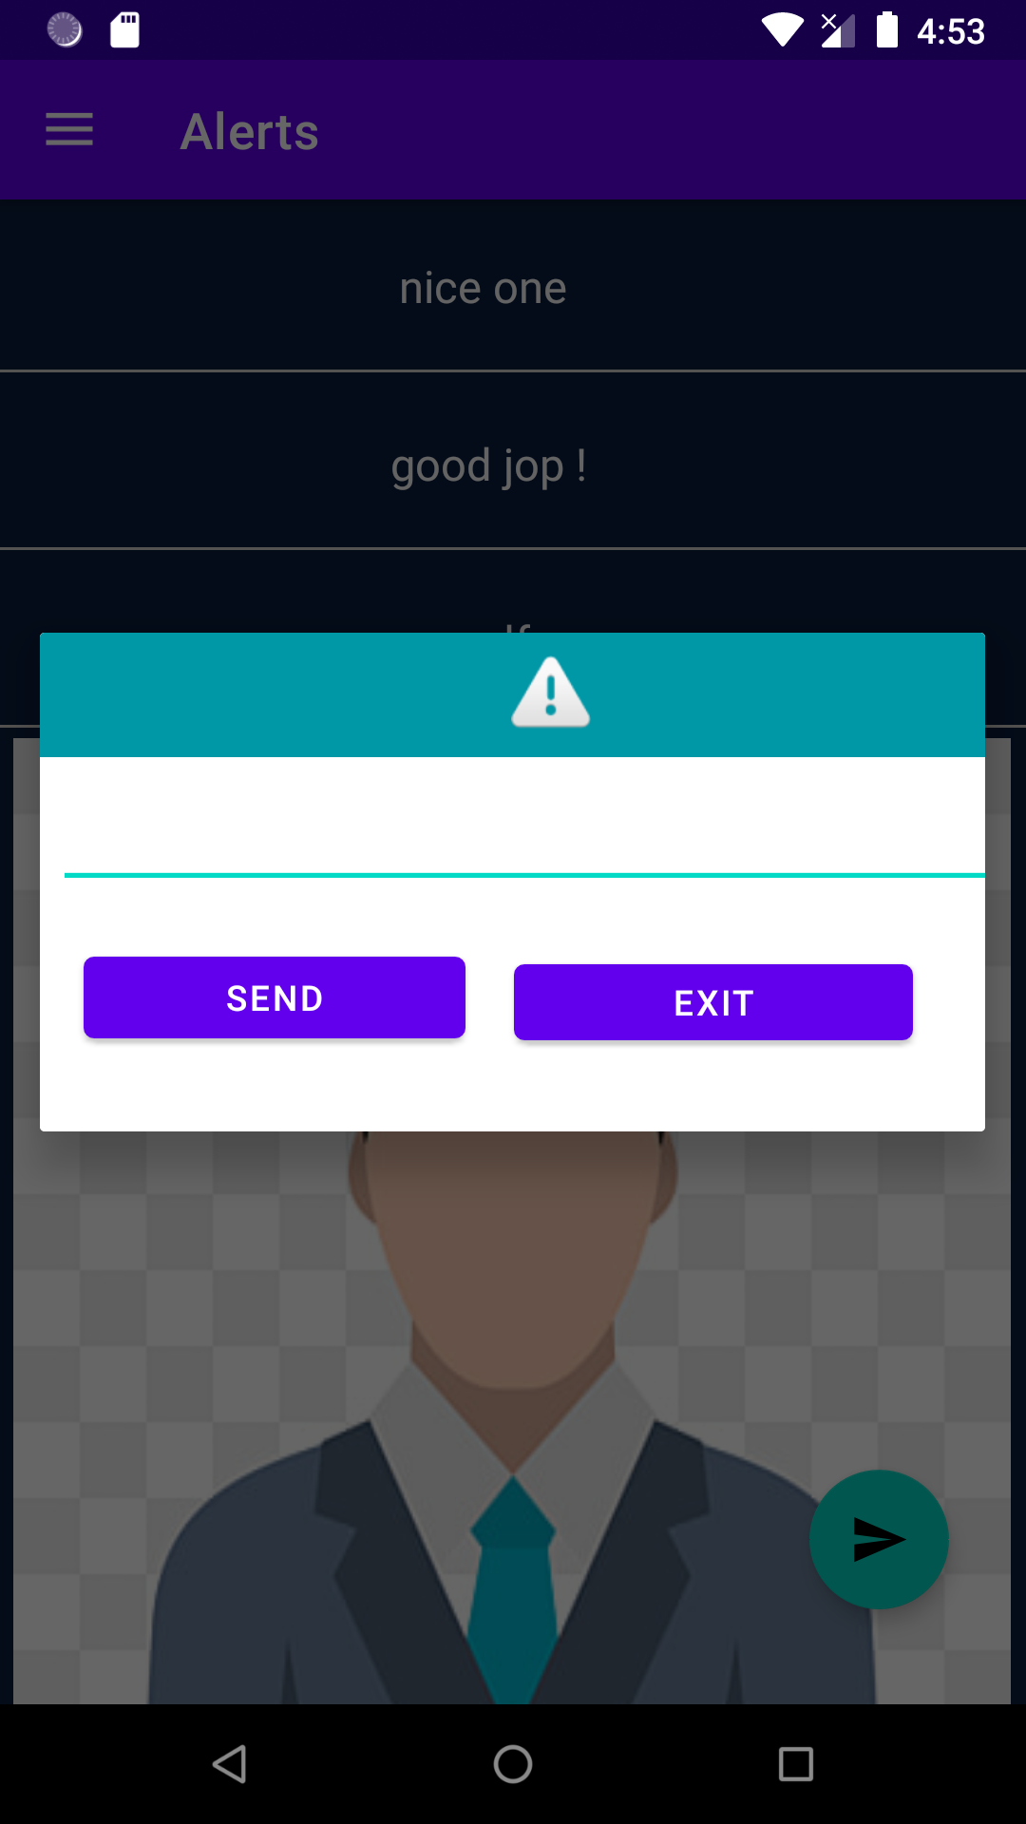
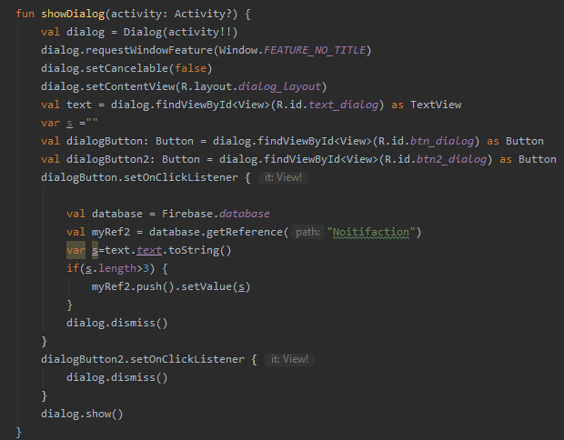
This Dialog Appear To User Who Is Type “ Teacher” :

Slide 36
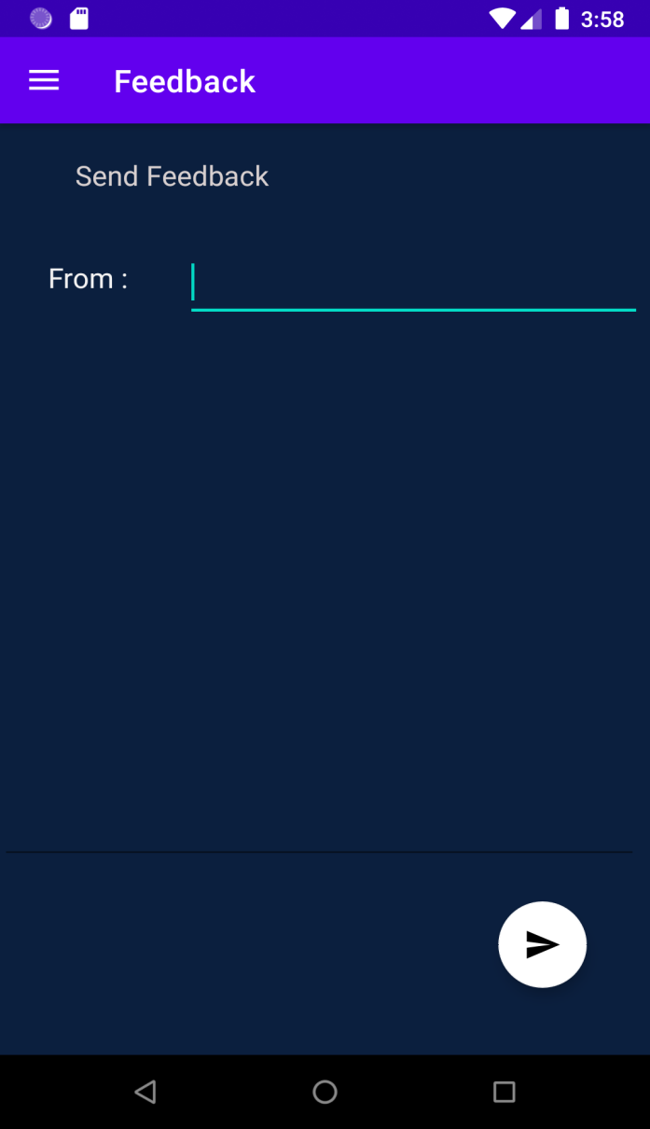
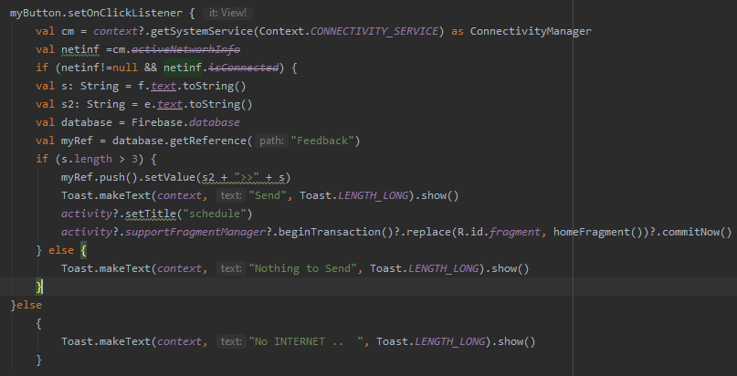
Send Feed Back :

Slide 37
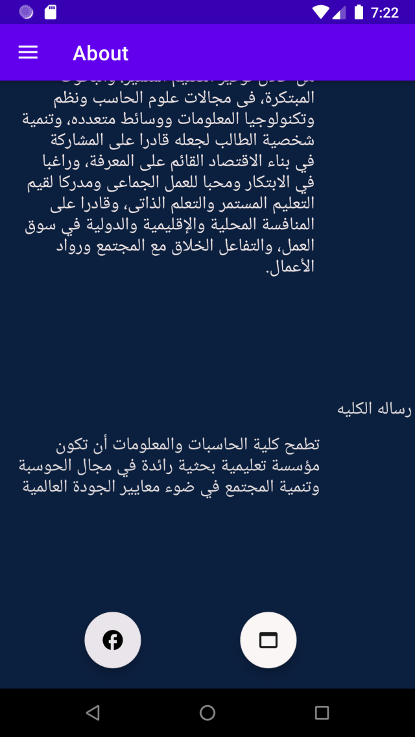
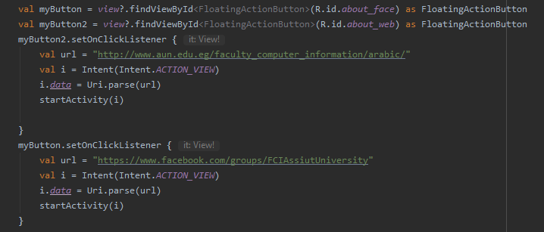
You can access the college website, location, and the page on Facebook .

Slide 38
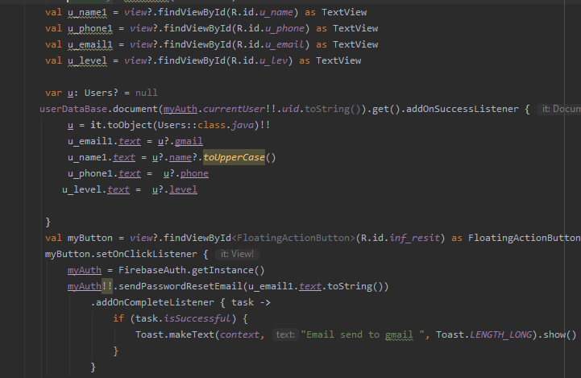
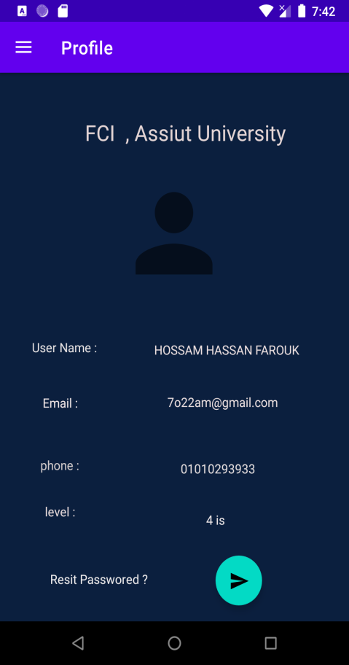
User Profile :

Slide 39
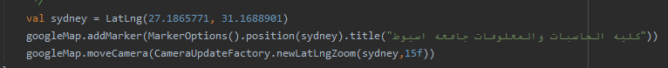
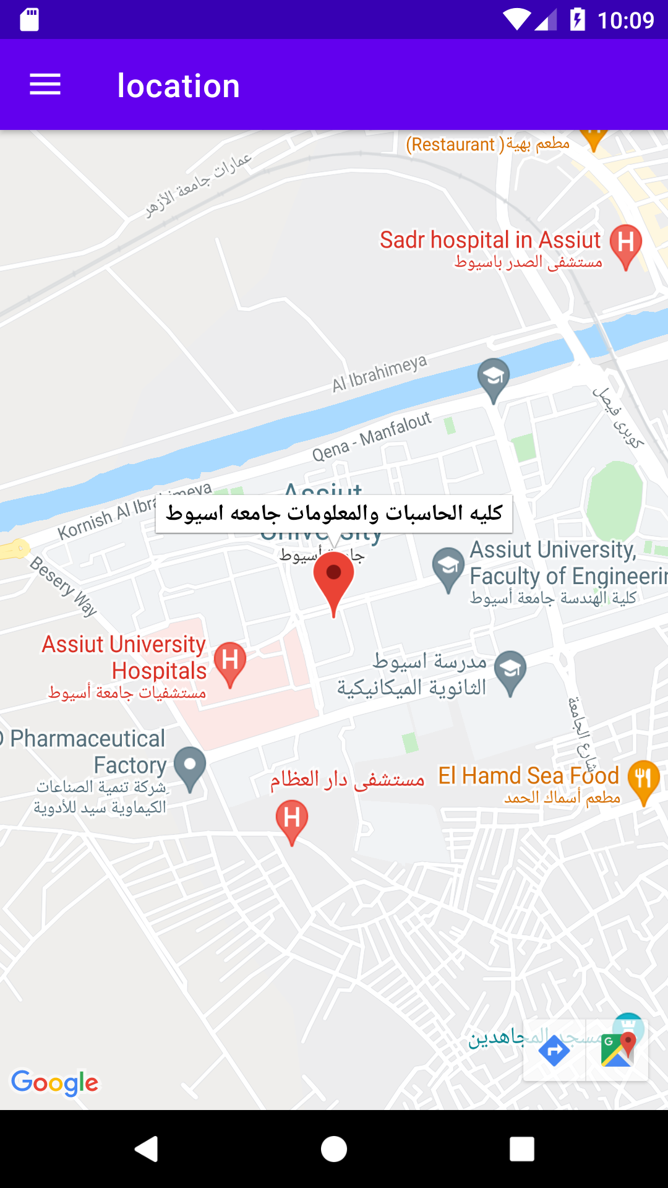
Location :

Slide 40
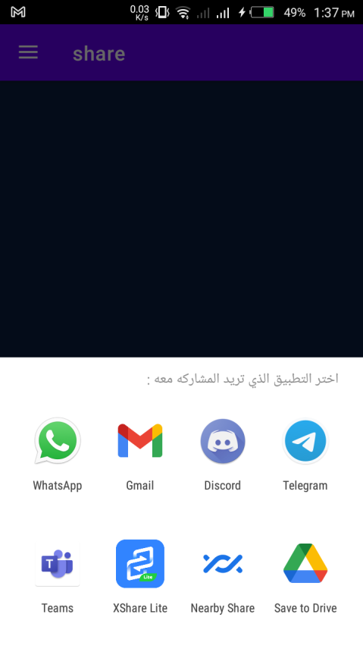

Share Application :

Slide 41
Thank You

